Slide 1
Principles of Mobile architecture
With Xamarin
Yair Segal
ysegal@mypeachsoftware.com

Slide 2
Content
What's architecture why we need it what's “SOLID”
What are the “Mobile” challenges
Layers- Spaghetti, Lasagna, Onion
Early considerations
Demo

Slide 3
What's in software architecture
Think big picture
Why Single responsibility Open-closed Liskov Interface Dependency injection
set of techniques and patterns used to develop fully structured mobile applications based on industry and vendor specific standards. While formulating the app architecture, the procedures that work on the wireless mobile device like smartphones and tablets are also taken into consideration

Slide 4
Challenges unique to mobile
Device types: Screen resolution, Size of screen, CPU characteristics, Memory, Availability of development framework, Storage space
Network bandwidth, Power consumption, limited network, cache, data access, State management
UI navigation style: Stacked navigation bar, Tab controller, Single view, Gesture-based navigation, Scroll views, Search driven navigation

Slide 5

Spaghetti code

Slide 6
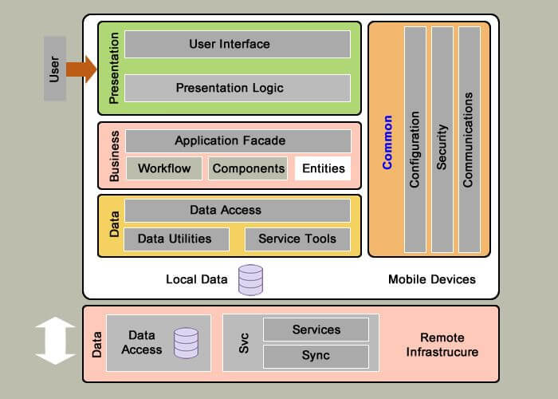
Layers

Slide 7
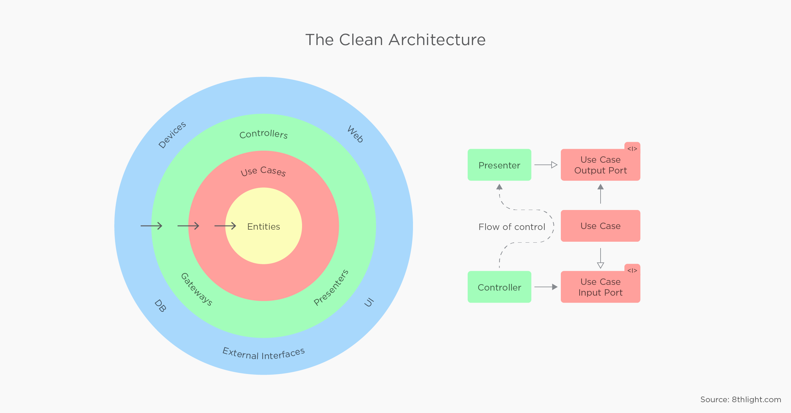
Onion or clean architecture

Slide 8
Clean architecture continued
Core – Maps to the layers that hold the Use Case and Entity concerns and is also where our External Interfaces get defined. These innermost layers contain our domain objects and business rules. no network connections, databases, etc. allowed. Interfaces represent those dependencies, and their implementations get injected
Infrastructure – Maps to the layers that hold the Database and Gateway concerns. In here, we define data entities, database access (typically in the shape of repositories), integrations with other network services, caches, etc. This project/layer contains the physical implementation of the interfaces defined in our domain layer.
Application layer

Slide 9
Early consideration
Audience
Platforms
Talent
App type – Native, Web, Hybrid, deploy anywhere
technology

